Slide 1
Building a Flight Ticket Booking System with MERN Stack
NAAN MUDHALVAN PROJECT
Submitted by:
Moazzam Ali, Nithishkumar, Nandhakumar, Naveen Raj
B.E. Computer Science and Engineering,
T. J. Institute of Technology, Chennai.

Slide 2
Team Members
Moazzam Ali
Nandhakumar A S
Naveen Raj A
Nithishkumar R

Slide 3

Introduction
Purpose of the App:
To allow users to search, book, and manage flight tickets.
To provide an easy-to-use interface for booking flights with real-time data.
To enable payment integrations and reservation tracking.
Target Audience:
Individuals and businesses seeking a quick and efficient way to book flight tickets.
In this presentation, we will explore streamlining travel through a Flight Ticket Booking System built using the MERN stack. This system will enhance user experience and simplify the process of booking ﬂights. Let's dive into the components and architecture that make this system efﬁcient.

Slide 4

Understanding the MERN Stack
The MERN stack consists of MongoDB, Express.js, React, and Node.js. Each component plays a crucial role in building a modern web application. MongoDB handles data storage, while Express.js and Node.js manage server-side operations, and React provides a dynamic user interface.

Slide 5
MERN Stack Overview
MongoDB: NoSQL database to store user data, flight details, bookings, and payment information.
Express.js: Web framework to handle HTTP requests and routing on the server side.
React: Frontend library for building an interactive and dynamic user interface.
Node.js: JavaScript runtime to run the server-side code (Express) and handle API requests.
Before development, it's essential to establish system requirements. Key features include user authentication, ﬂight search, booking management, and payment processing. Understanding these requirements will guide the design and implementation of the application.

Slide 6
Key features
User Registration and Login: Allow users to create accounts and log in securely using email and password or social media accounts.
User Profiles: Enable users to manage their profiles, view booking history, and save preferences (e.g., frequent flyer information, payment methods).
Search Functionality: Users can search for flights based on departure and arrival locations, dates, number of passengers, and cabin class (e.g., economy, business).
Flight Information: Display detailed information for each flight, including airline, departure and arrival times, duration, layovers, and prices.
Compare Flights: Allow users to compare multiple flights side-by-side based on their criteria.
Booking Process: Streamline the booking process with a clear step-by-step interface for selecting flights, entering passenger details, and confirming payment.
Secure Payment Processing: Integrate with popular payment gateways (e.g., Stripe, PayPal) to handle transactions securely.

Slide 7
Database Design with MongoDB
Collections:Users: Stores user details like name, email, password, and booking history.
Flights: Stores flight details like flight number, source, destination, price, available seats.
Bookings: Stores booking information, linked to users and flights.
Payments: Stores payment transactions related to bookings.
Using MongoDB, we can design a ﬂexible database schema. Key collections include users, ﬂights, and bookings. This design allows for efﬁcient data retrieval and storage, ensuring a smooth user experience during ﬂight searches and bookings.

Slide 8
Tech stack and tools
Frontend:
React: For building a dynamic user interface.
React Router: For navigation between different views (search, booking, profile, etc.).
Axios/Fetch API: For making HTTP requests to the backend.
Backend:
Node.js: Server-side JavaScript runtime.
Express.js: Web framework to handle routes and API calls.
JWT (JSON Web Token): For user authentication and authorization.
Database:
MongoDB: To store and manage data.
The backend of our system is built with Node.js and Express.js. This combination allows us to create a robust API that handles user requests, manages ﬂight data, and processes bookings. Middleware will be utilized for error handling and data validation.

Slide 9
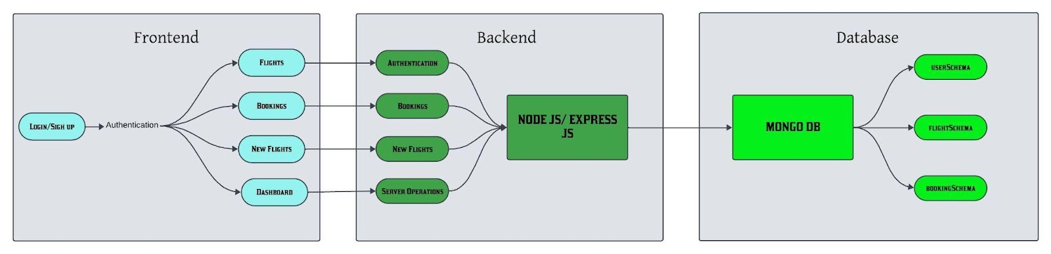
App Architecture Diagram
Frontend (React) interacts with the Backend (Node.js/Express)
Backend (Node.js/Express) communicates with the MongoDB database

Slide 10
App Flow
Homepage: Users see a search form to find flights.
Search Results: Flights are displayed based on user input (date, destination, etc.).
Booking: Users can select a flight and proceed to book.
Payment: After booking, users can pay using a payment gateway.
Confirmation: User receives a confirmation and can check booking history.

Slide 11
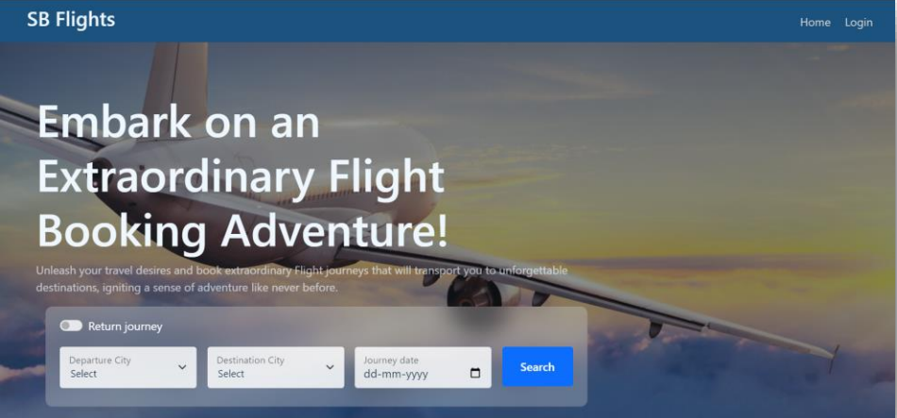
User Interface Screens
Landing Page UI

Slide 12
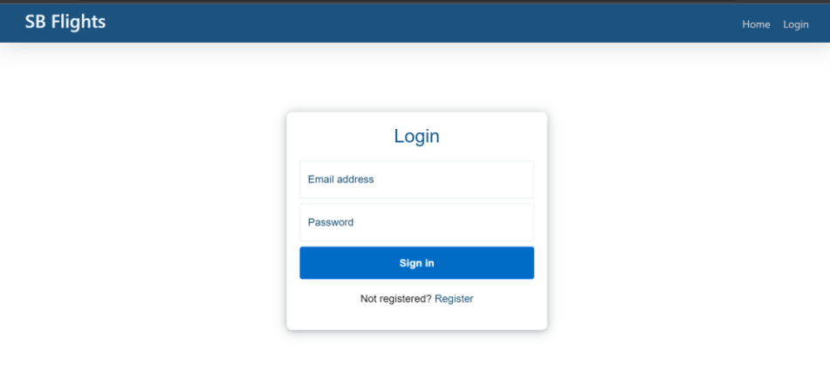
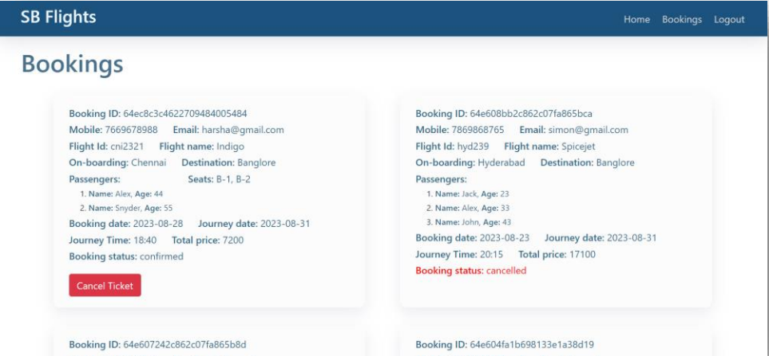
Authentication
User Bookings

Slide 13
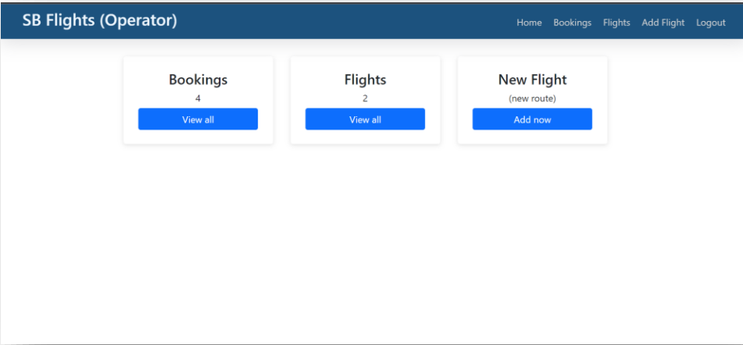
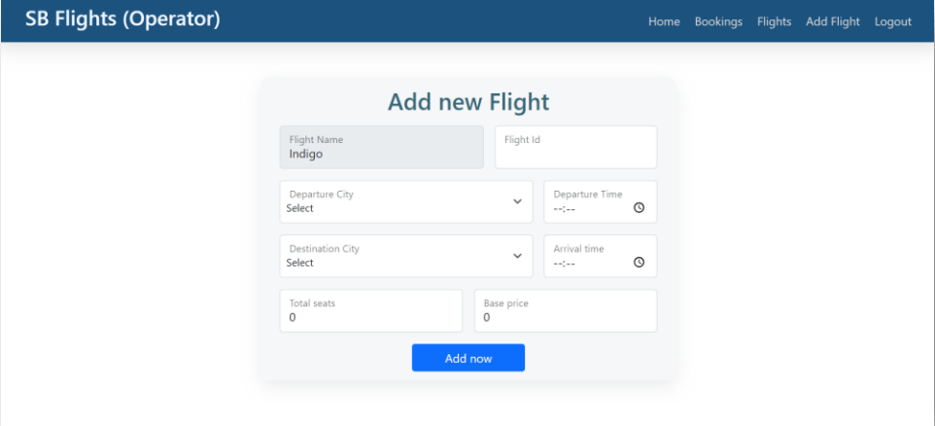
Flight Operator
Add New Flight

Slide 14
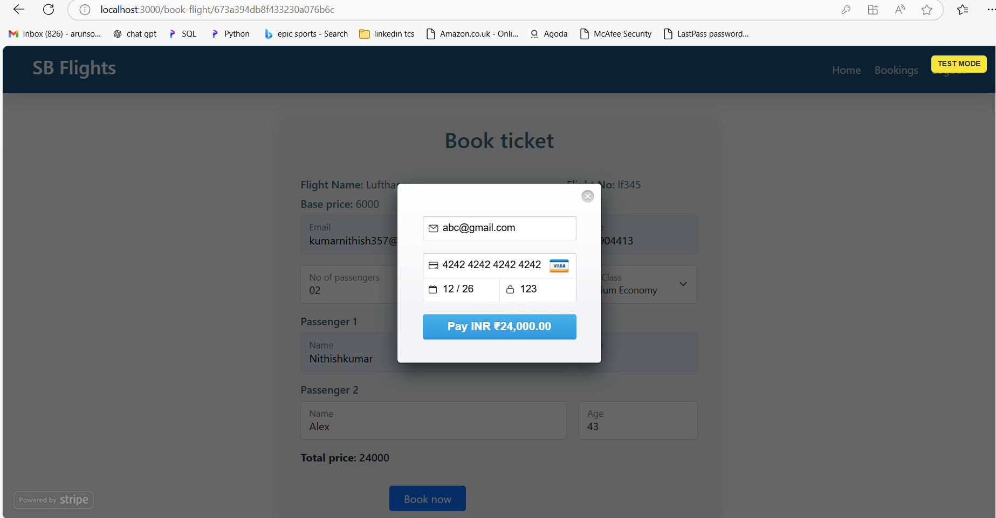
Integrating Payment Processing
To facilitate transactions, we will integrate a secure payment processing system.
Options like Stripe or PayPal can be used. Ensuring PCI compliance is crucial to
protect user data during payment transactions.

Slide 15
Challenges and solutions
Challenges:
Handling real-time flight data.
Integrating payment gateways.
Ensuring a smooth user experience across devices.
Solutions:
Use APIs for real-time flight data.
Leverage Stripe/PayPal SDK for payment integration.
Ensure responsive design with CSS frameworks like Bootstrap or Material-UI.

Slide 16

Testing the Application
Thorough testing is essential to ensure the application functions correctly. We will conduct unit tests, integration tests, and user acceptance tests. This process helps identify and resolve potential issues before deployment.

Slide 17

Deployment and Hosting
Once testing is complete, we will deploy the application on a cloud service like Heroku or AWS. Proper hosting ensures scalability and availability, allowing users to access the ﬂight booking system anytime, anywhere.

Slide 18
Future Enhancement
Multi-language Support: Allow users to choose their preferred language.
Flight Recommendations: Based on user preferences and search history.
Mobile App: Developing a mobile app version using React Native.
Admin Dashboard: More advanced analytics and reporting features for administrators.

Slide 19
Conclusion
In conclusion, building a Flight Ticket Booking System with the MERN stack streamlines travel processes and enhances user experience. By focusing on key components and best practices, we can create a robust and efﬁcient application that meets user needs.
The Flight Booking App offers a user-friendly and efficient platform for searching, booking, and managing flights. Built with the MERN stack, it ensures high performance, scalability, and security. Key features include real-time flight data, secure payment processing, and an intuitive interface for both users and admins. With potential for future enhancements like multi-language support and mobile app development, the app is poised to provide a comprehensive travel solution.

